Slide 1
Chapter 21: Cluster Analysis
Textbook: Ahmad Daryanto, Introduction to Quantitative Research Methods for Marketing With SPSS and R: Tools and Techniques, Routledge. 2024

Slide 2
Learning Objectives
Understand the principles of a hierarchical clustering technique
Know how to perform a cluster analysis using a hierachical clustering with SPSS and R, which includes:
Know how to read a proximity matrix table
Know how to read a dendogram
Know how to interpret a cluster solution
Understand the principle of validation for checking the quality of cluster solutions

Slide 3
Goal
Categorizing objects or entities such as customers, organizations, markets, products, events, and so on, into groups or clusters based on similarities in their characteristics, attitudes, behaviours, or preferences.
Cluster analysis is considered as one of the machine learning techniques called unsupervised learning

Slide 4
Similarity/Distances
Cluster analysis is based on the principle of similarity. That is two objects that are similar are merged together, and other objects were combined in successive orders based on on their similarity with the previous objects or clusters. At the end, objects in one cluster have small differences (i.e., small within-cluster variance), but large differences with those in other clusters (i.e., large between-cluster variance).
Cluster analysis is essentially “a numerical procedure for computing distances among points and grouping points according to their closeness in the n-dimensional space”. (Green et al., 1967, p. 389).

Slide 5
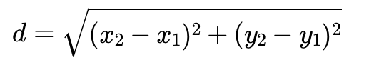

Distances
Pythagorean theorem:
Euclidean Distance
$$c^{2}=a^{2}+b^{2}$$
If an object has a coordinate (x1,y1), and another object has a coordinate (x2,y2) in a scatter plot. The Euclidean distance is given by
c
b
a

Slide 6
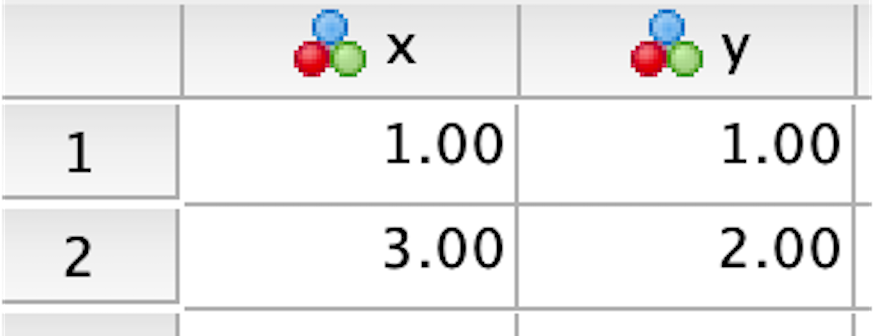
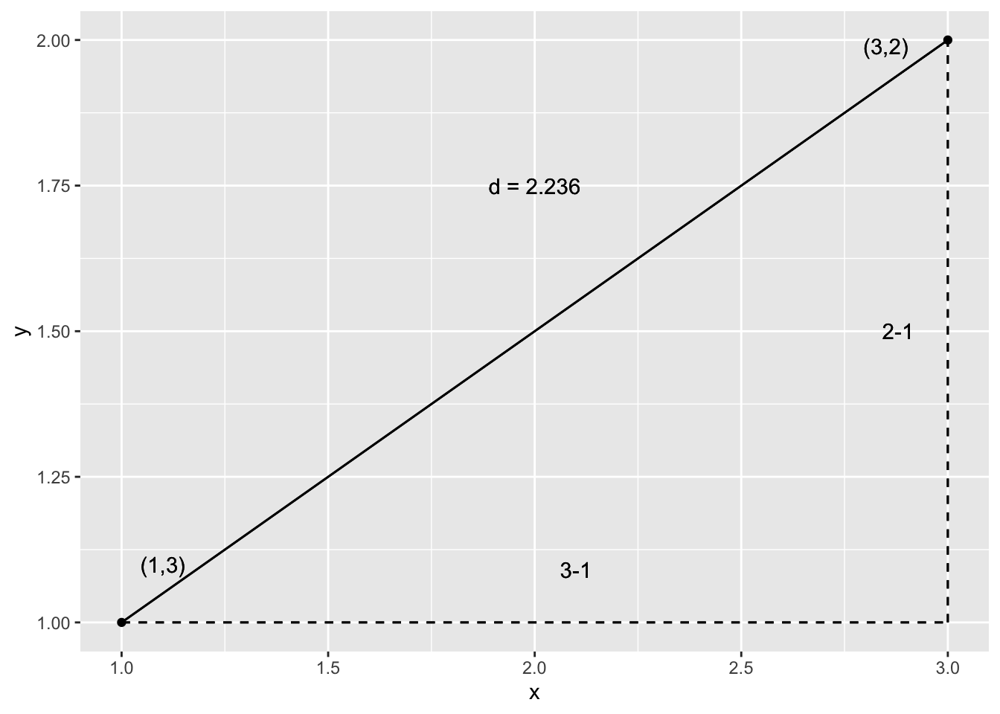
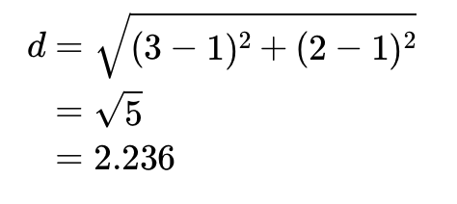
Distance

Slide 7
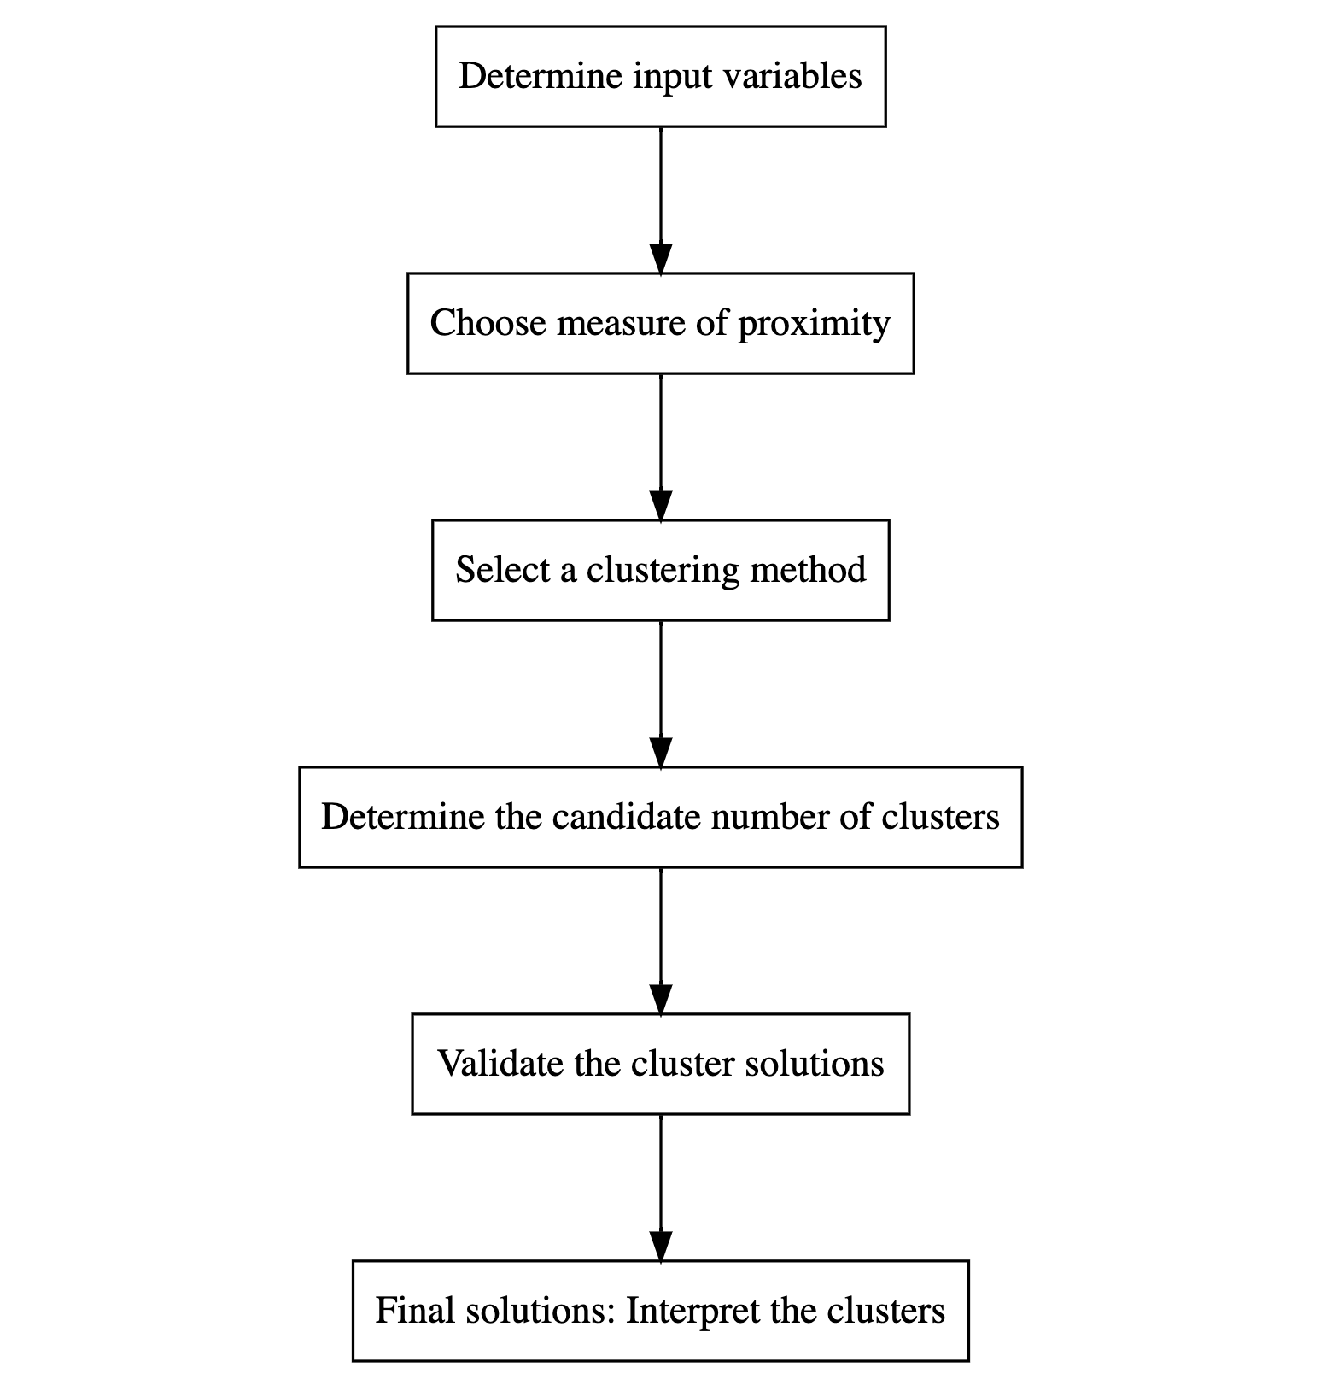
CA Procedure

Slide 8
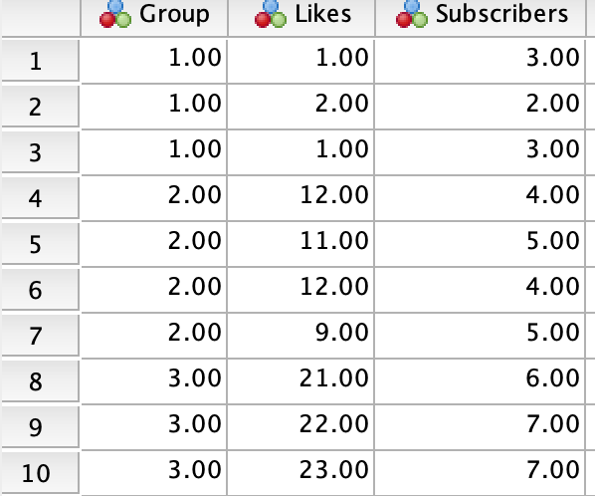
SPSS Action
Data: YouTube.sav
DATASET DECLARE D0.5678863817867955.
PROXIMITIES Likes Subscribers
/MATRIX OUT(D0.5678863817867955)
/VIEW=CASE
/MEASURE=EUCLID
/PRINT NONE
/STANDARDIZE=VARIABLE Z.
CLUSTER
/MATRIX IN(D0.5678863817867955)
/METHOD WARD
/PRINT SCHEDULE
/PLOT DENDROGRAM VICICLE.
Dataset Close D0.5678863817867955.

Slide 9
Cluster 3
Cluster 2
Cluster 1
Three cluster solutions

Slide 10
Showing the process of merging clusters

Slide 11
Dendogram
A dendogram is a tree-like structure, showing the progression of merging clusters at each step of the clustering process.

Slide 12
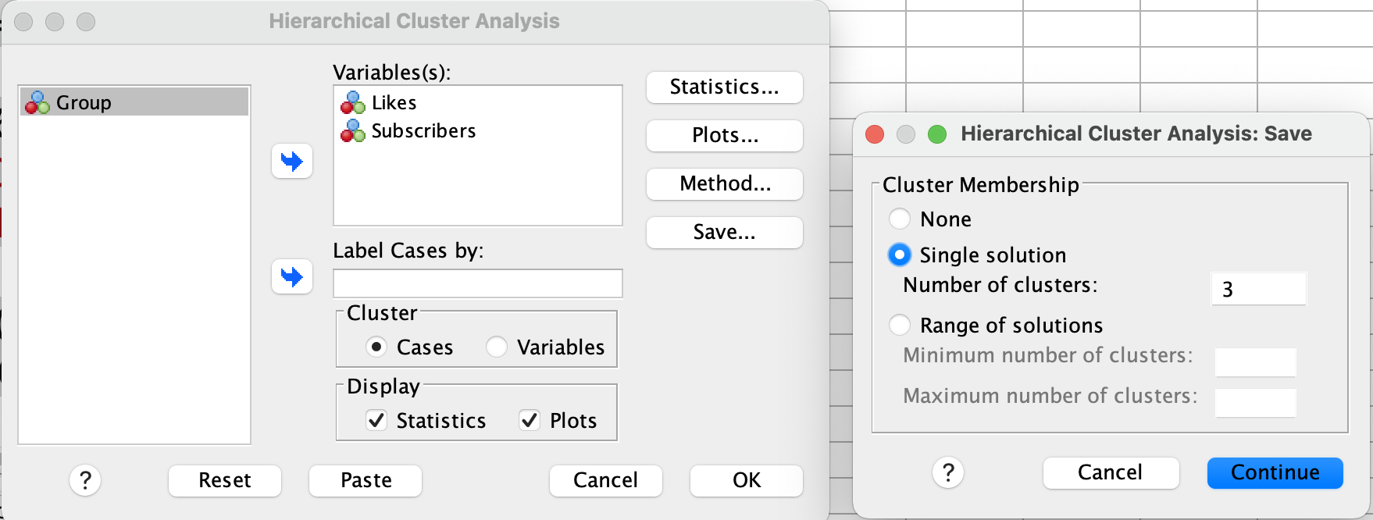
Saving Cluster Membership
DATASET DECLARE D0.680961199734334.
PROXIMITIES Likes Subscribers
/MATRIX OUT(D0.680961199734334)
/VIEW=CASE
/MEASURE=EUCLID
/PRINT NONE
/STANDARDIZE=VARIABLE Z.
CLUSTER
/MATRIX IN(D0.680961199734334)
/METHOD WARD
/PRINT SCHEDULE
/PLOT DENDROGRAM VICICLE
/SAVE CLUSTER(3).
Dataset Close D0.680961199734334.

Slide 13
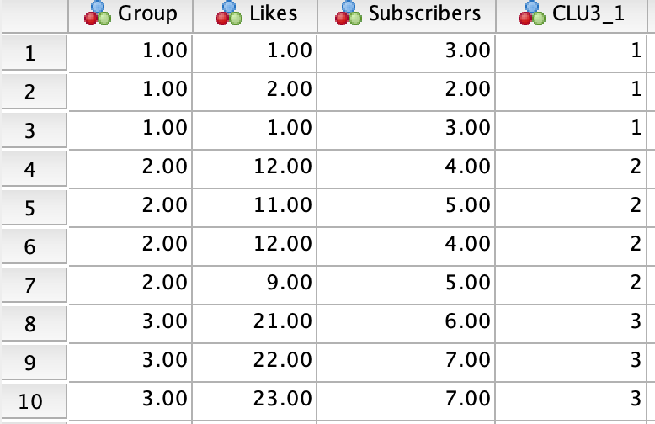

Slide 14
R Action
rm(list=ls())
library(tidyverse)
library(haven)
library(cluster)
library(factoextra) # to use fviz_silhouette()
dat <- read_spss("/Users/ahmaddaryanto/Documents/Data1/youtube.sav")
distance_matrix <- dist(dat, method = "euclidean")
# round the results to 3 decimal places
round(distance_matrix,3)
fit <- hclust(distance_matrix, method = "ward.D")
Fit
plot(fit)
cut_dendogram <- cutree(fit, k = 3)
cut_dendogram
evaluate_cluster <- silhouette(cut_dendogram, distance_matrix)
evaluate_cluster
fviz_silhouette(evaluate_cluster)
dat <- dat %>%
mutate(cluster=cut_dendogram)
# let us view the data
dat

Slide 15
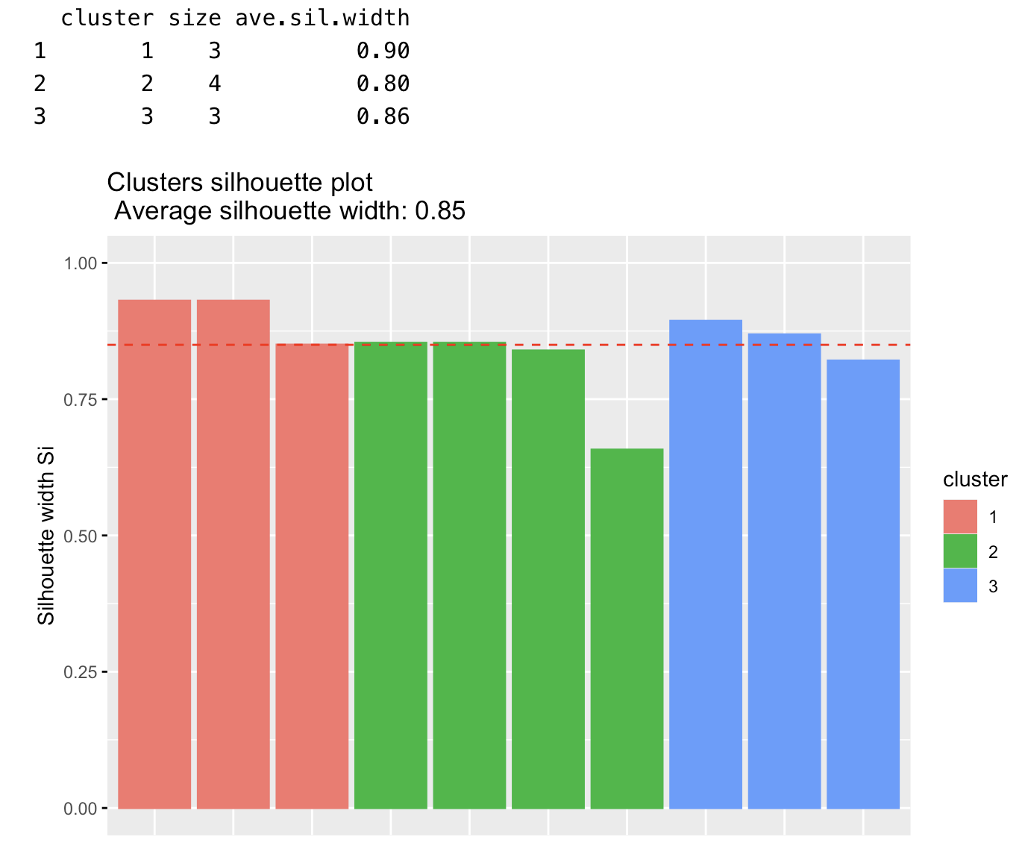
Output Of The fviz_silhouette() Function
Silhouette widths are above 0.8 indicating an excellent fit.
As can be seen from the figure, the average value of the silhoutte width is above 0.8 showing an excellent fit

Slide 16
Further Readings
Harvey, J. W. (1990). Benefit segmentation for fund raisers. Journal of the Academy of Marketing Science, 18(1), 77-86.
Punj, G., & Stewart, D. W. (1983). Cluster Analysis in Marketing Research: Review and Suggestions for Application. Journal of Marketing Research, 20(2), 134–148.
Romesburg, C. (2004). Cluster analysis for researchers.
Wedel, M., & Kamakura, W. A. (2000). Market segmentation: Conceptual and methodological foundations. Springer Science & Business Media

